Slide 1
Life Processes 1.lifeprocess 2.nutrition
CHAPTER SIX – 6.1

Slide 2
What are Life process
All the living organisms including human beings perform a number of activities such as nutrition, respiration, excretion, growth and reproduction. ... These maintenance function of living organisms are known as life processes.
The maintenance functions of living organisms must go on even when they are not doing anything particular.

Slide 3
NUTRITION
we are using up energy. Even when we are not doing any apparent activity, energy is needed to maintain a state of order in our body.

Slide 4
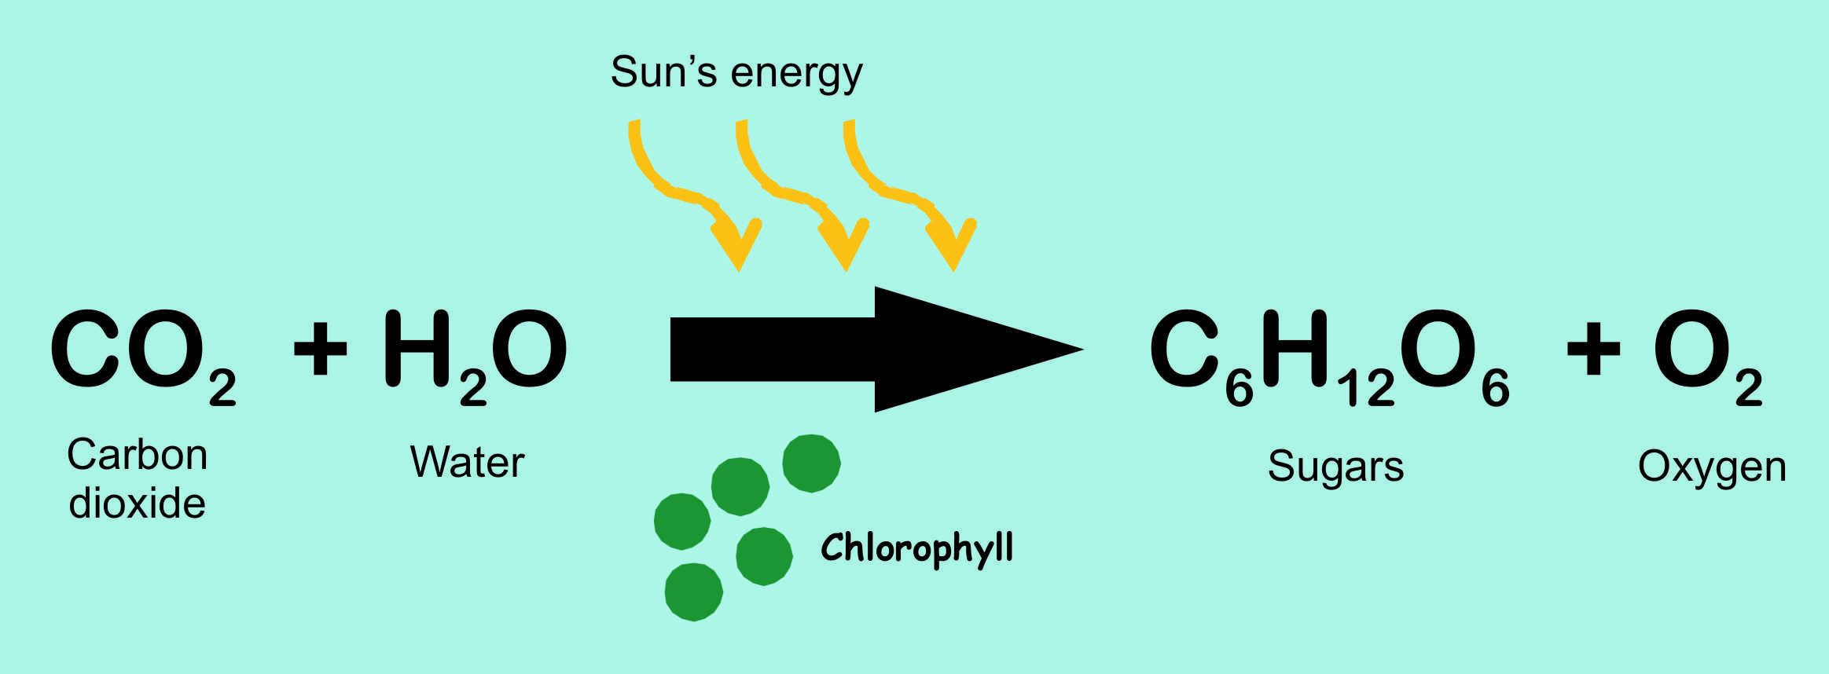
Autotrophic Nutrition
(i) Absorption of light energy by chlorophyll.
(ii) Conversion of light energy to chemical energy and splitting of water molecules into hydrogen and oxygen.
(iii) Reduction of carbon dioxide to carbohydrates
Notes:
Add Video of Photosynthesis

Slide 5
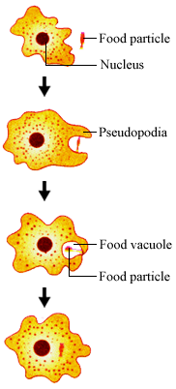
Heterotrophic Nutrition

Slide 6
Nutrition in human beings
Chewing
Digestion
Notes:
Add video of digestion in human

Slide 7
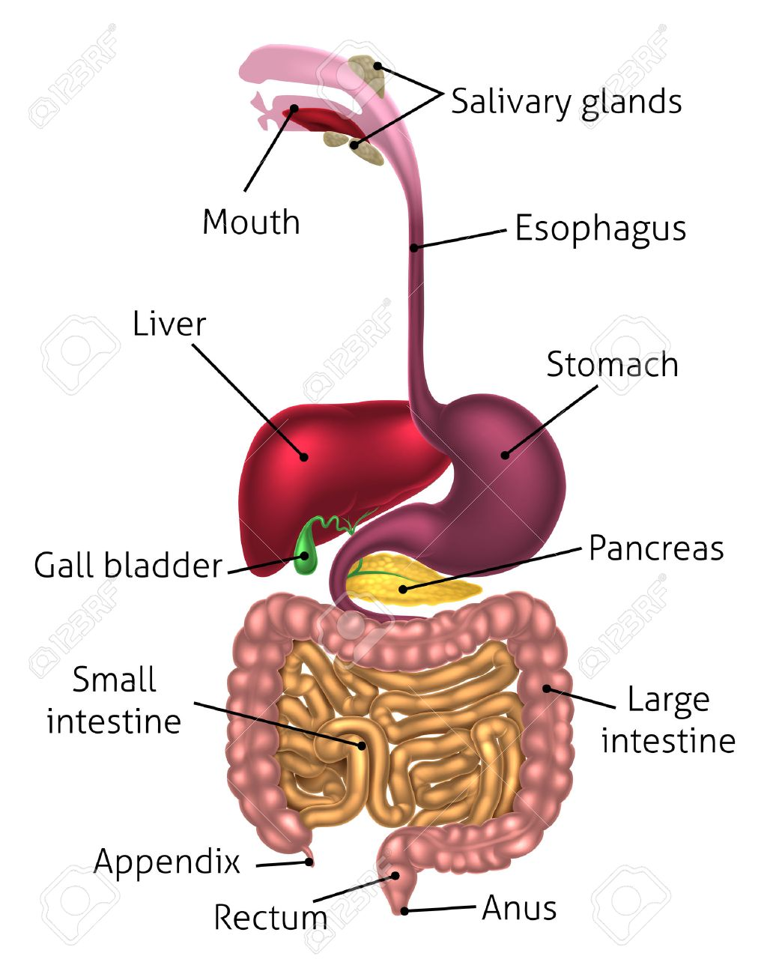
Digestive System

